Slide 1
Gesture
Vision
Team 7:
Shubh Desai
Shubham Mendapara
Deep Prajapati
Dhruv Patel

Slide 2
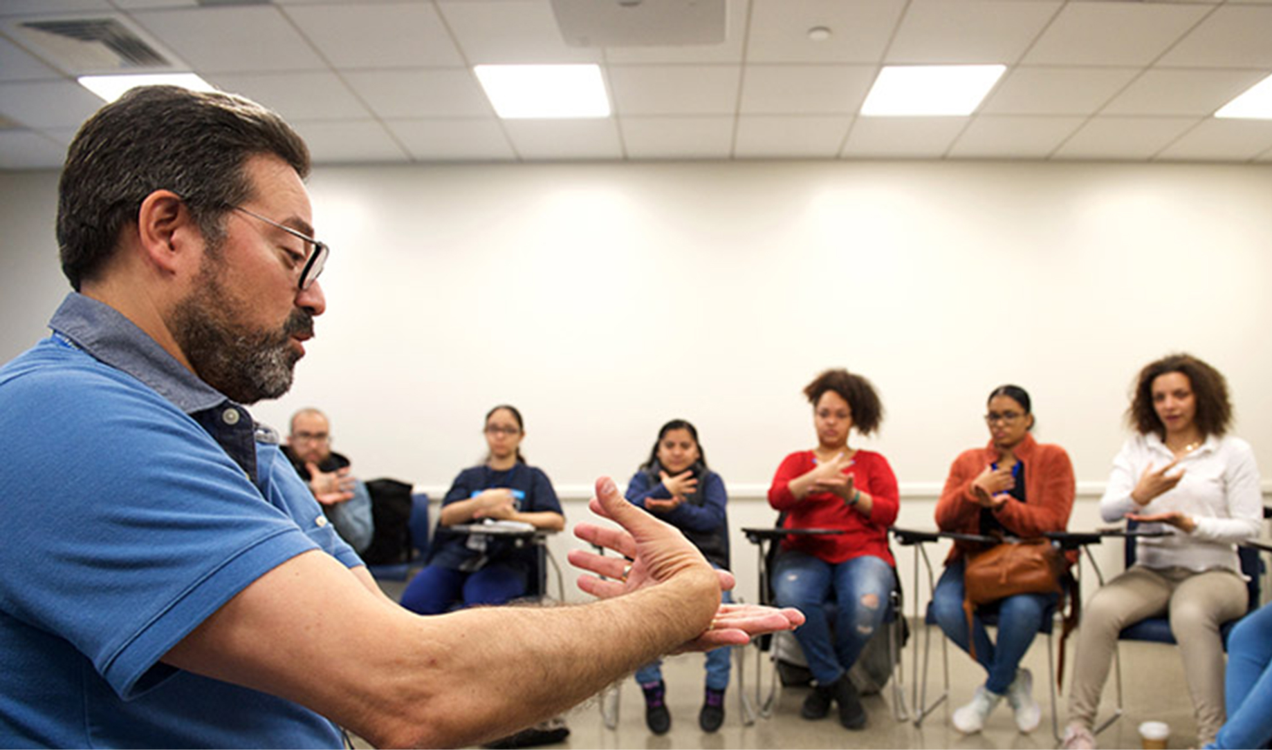
Problem Statement
1 Million People of ASL community faces challenges in communication
Still need of interpreter (50:1)
Improvement using AI
Notes:
Today, 1 million people of ASL community faces challenges in communication with other people.
Despite of boom in AI industry, there have not been any significant work in this area as the ratio of number of ASL users to certified interpreter is 50:1, expected to grow by 19% each year.
Even-though AI is becoming more powerful in several fields, year by year, technological improvement using AI for people suffering from hearing and speaking deficiencies have reduced. We tried to make better the existing solution.

Slide 3
Dataset
01 | ASL Alphabet dataset
 | Datasets used for training and testing using CNN.
02 | Auto Word prediction dataset
 | Datasets used for predicting next word using RNN.
03 | text-to-speech synthesis
 | Converts the recognized text into spoken using gTTs.
Notes:
For this project, we have used two types of Dataset. First we have collected numerous images of Sign language alphabets, resized them, and performed data augmentation techniques like blur and brightness adjustments.For the second, we have collected conversation between humans to create a conversational dataset.
(Move to next)

Slide 4
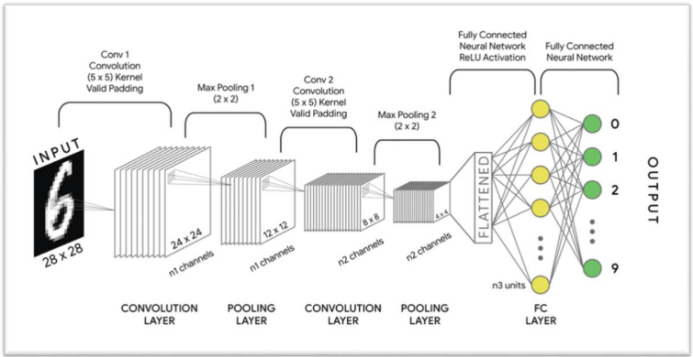
Model Architecture
Convolutional Neural Network (CNN)
01
Process and interpret
sign gestures
Fast Autocomplete
02
Significantly enhances smoother and user experience
Text-to-Speech (gTTS)
04
Converts predicted text into spoken language
03
Recurrent Neural Network (RNN)
Handle sequential data for next word prediction
Notes:
Starting with Convolutional Neural Network (CNN), it serves as the backbone of our project. we opted for Convolutional Neural Networks because of its exceptional performance in image recognition tasks. We created its architecture using Convolutional, filter and max pooling in sequence, to efficiently process and interpret sign gestures, enabling real-time recognition. We fine-tuned parameters of this model to optimize performance.
Moving on to fast_autocomplete. Is is used to autocomplete the current word user is trying to frame. We chose it as its speed and accuracy outperformed other options we considered (which options?). Integration of it within our project ensures smoother and more efficient communication flow, reducing cognitive load for users.
Additionally, we are also providing next word prediction using a Recurrent Neural Network (RNN). RNNs are widely known for their ability to handle sequential data, so we chose it for this task. We crafted the RNN architecture using Embedding, LSTM and Dense layers in sequence while fine-tuning its hyperparameters to optimize to anticipate the word that user might be willing to say.
Last but not least, we added Google Text-to-Speech (gTTS) to translate the user words into different spoken languages, ensuring better communication.
Combining all these models provide a powerful toolkit for eficient communication without a human translator.

Slide 5
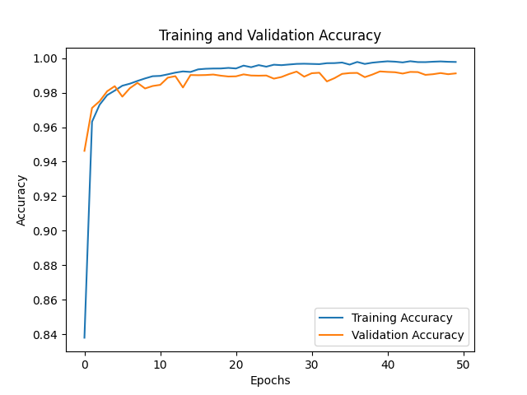
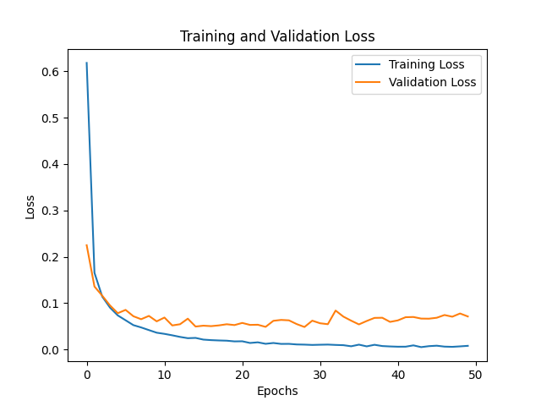
CNN Training and Validation Metrics
Notes:
Here, for accuracy, we can see that the training accuracy has rapidly increased for first 10 iterations leading towards overfitting but then it grows gradually along with validation curve suggesting that the model is learning well, which can be confirmed through Test Accuracy of 98%.
In the loss curve, we can see the same trend of steep decrease of loss initially but then gradual decrease of it with validation loss indicating that the model is generalized well to unseen data.

Slide 6
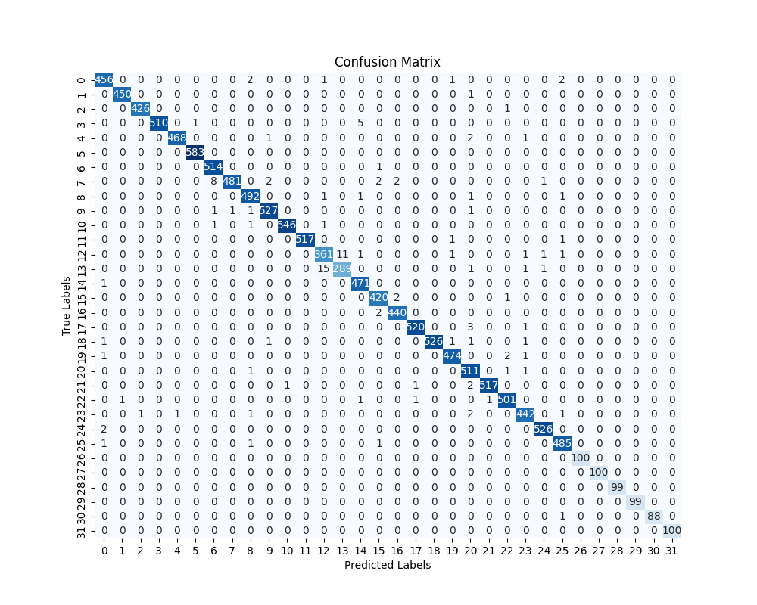
CNN Confusion Metrics
Notes:
Here, we can see that, majority of the numbers on the diagonal axis, hinting correct prediction of labels. The off-diagonal entries can be used to understand the miss-classification of data by model.

Slide 7
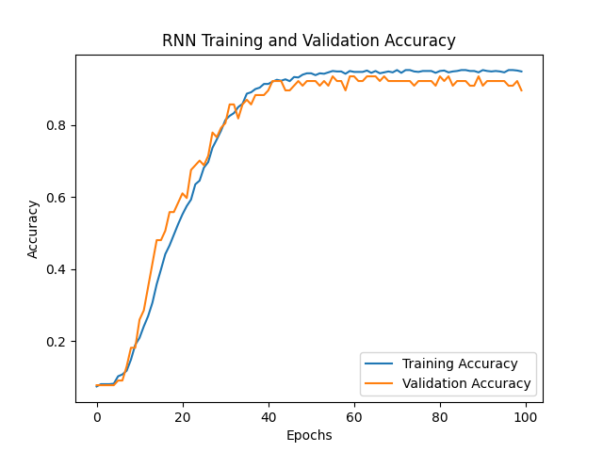
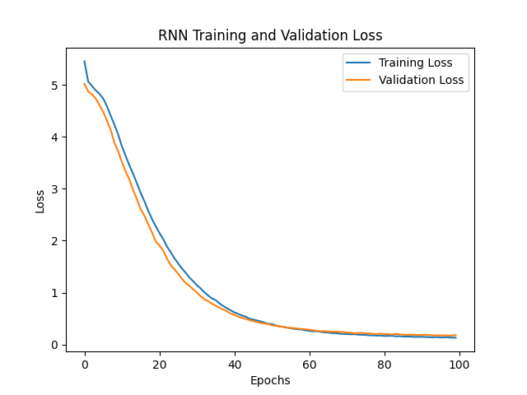
RNN Training And Validation Metrics
Notes:
Old:
The RNN model learns well throughout the training process as the training curve increases gradually from start to end with validation curve resulting with test accuracy of 98%. Similarly, the model classifies the unseen data well confirmed through the gradual decrease of training loss with validation loss.
New:
Both of these graphs for training and validation accuracy shows gradual increase and decrease respectively, confirming that the model is learning well.

Slide 8
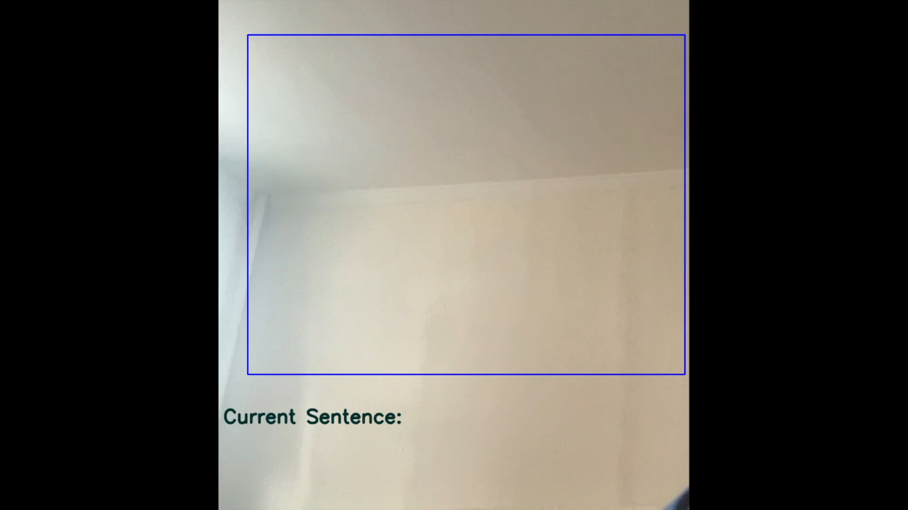

Slide 9

Summary (Why should you care?)
Customer Relation
For whom we care ?
Learn from Project
The Models
Developed AI translation tool
Key eyesight
Our key insight?
Future
Expand more sign languages
Notes:
As we wrap up our presentation, let’s see why should you care.
Approximately, 4.5 million people in the world suffers from hearing or speaking deficiency experiencing communication as the biggest barrier. Despite, of technological advancement with AI, works to mitigate these communication barriers are decreasing year by year.
Training models like Convolutional Neural Network with diverse dataset containing numerous different labels or video encoded files with utilizing libraries like OpenCV can efficiently detect and predict a specific gesture. Adding Sequential models on top of it like Recurrent Neural Network can help making their life easy by predicting what they are trying to say and convert it into speech.
The difference between our project and existing ideas is the combination of different models used as toolkit, which can effectively reduce the need of human translator, allowing them to feel connected.
In future, with advancement in AI technologies and processors, more features with complex dataset can be added to this toolkit making it more usable and efficient.
In conclusion, our project isn't just about technology; it's about people. It's about creating connections, fostering understanding, and building a more inclusive world for all.

Slide 10
Thank You.
Any Questions?

